Slide 1
Causal Inference

Slide 2
Reference
1
Hernán MA, Robins JM (2019). Causal Inference. Boca Raton: Chapman & Hall/CRC, forthcoming.
https://www.hsph.harvard.edu/miguel-hernan/causal-inference-book/
2
VanderWeele, T. (2015). Explanation in causal inference: methods for mediation and interaction. Oxford University Press.
https://www.amazon.com/Explanation-Causal-Inference-Mediation-Interaction/dp/0199325871

Slide 3
Contents
1
Overview. G-formula and inverse probability weighting
- Miguel Hernan
2
Marginal Structural Models and G-estimation of Structural Nested Models
- Judith Lok
3
Single World Intervention Graphs and other recent developments in causal inference
- James Robins
4
Causal Mediation Analysis
- Tyler VanderWeele
5
Causal Methods to Tame Unmeasured Confouding
- Eric Tchetgen Tchetgen

Slide 4
1
Overview. G-formula and inverse probability weighting
- Miguel Hernan

Slide 5
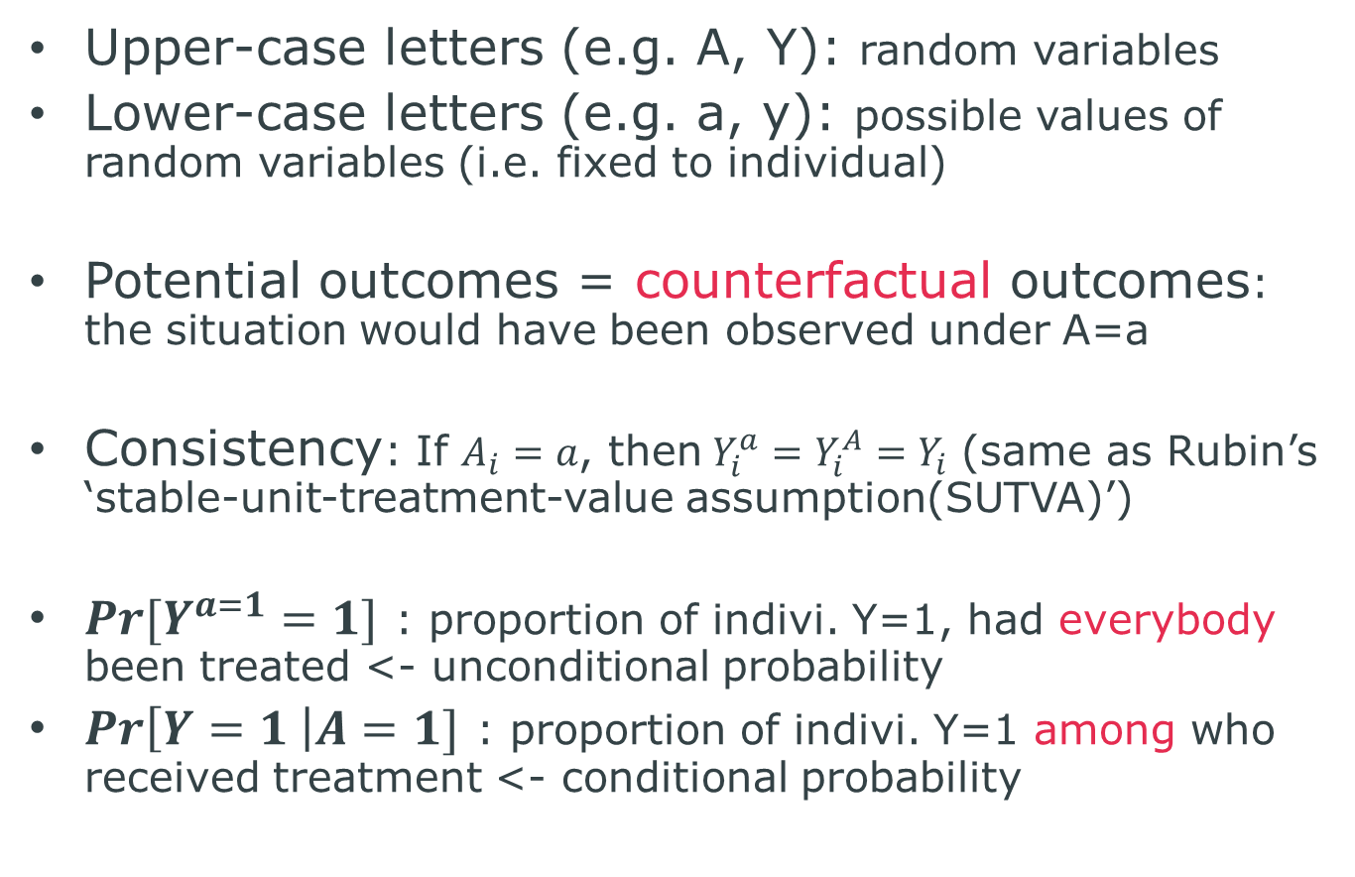
Terminology
Upper-case letters (e.g. A, Y): random variables
Lower-case letters (e.g. a, y): possible values of random variables (i.e. fixed to individual)
Potential outcomes = counterfactual outcomes: the situation would have been observed under A=a
Consistency: If $A_{i}=a$, then$Y_{i}^{a}=Y_{i}^{A}=Y_{i}$ (same as Rubin’s ‘stable-unit-treatment-value assumption(SUTVA)’)
$Pr[Y^{a=1}=1]$ : proportion of indivi. Y=1, had everybody been treated <- unconditional probability
$Pr\left[Y=1 \right|A=1]$ : proportion of indivi. Y=1 among who received treatment <- conditional probability

Slide 6
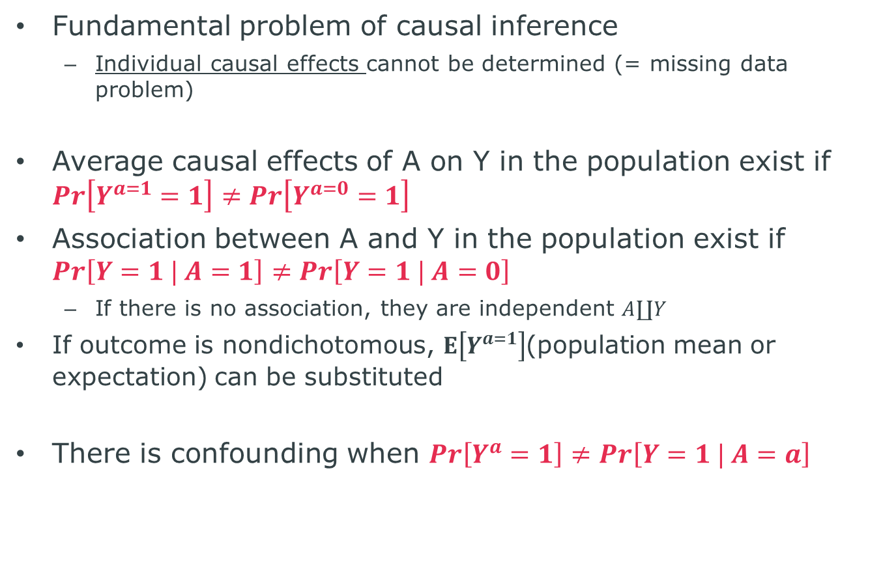
Association and Causation
Fundamental problem of causal inference
Individual causal effects cannot be determined (= missing data problem)
Average causal effects of A on Y in the population exist if $Pr\left[Y^{a=1}=1\right]≠Pr\left[Y^{a=0}=1\right]$
Association between A and Y in the population exist if $Pr\left[Y=1 | A=1\right]≠Pr\left[Y=1 | A=0\right]$
If there is no association, they are independent $A∐Y$
If outcome is nondichotomous, $E\left[Y^{a=1}\right]$(population mean or expectation) can be substituted
There is confounding when $Pr\left[Y^{a}=1\right]≠Pr\left[Y=1 | A=a\right]$

Slide 7
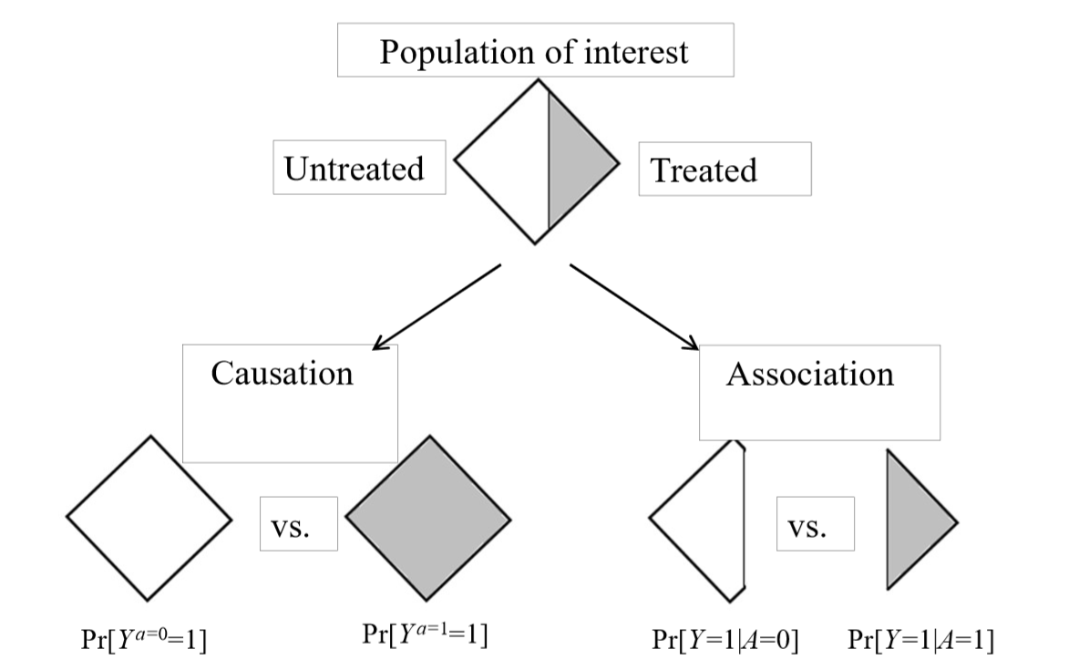
Definition of causal effects

Slide 8
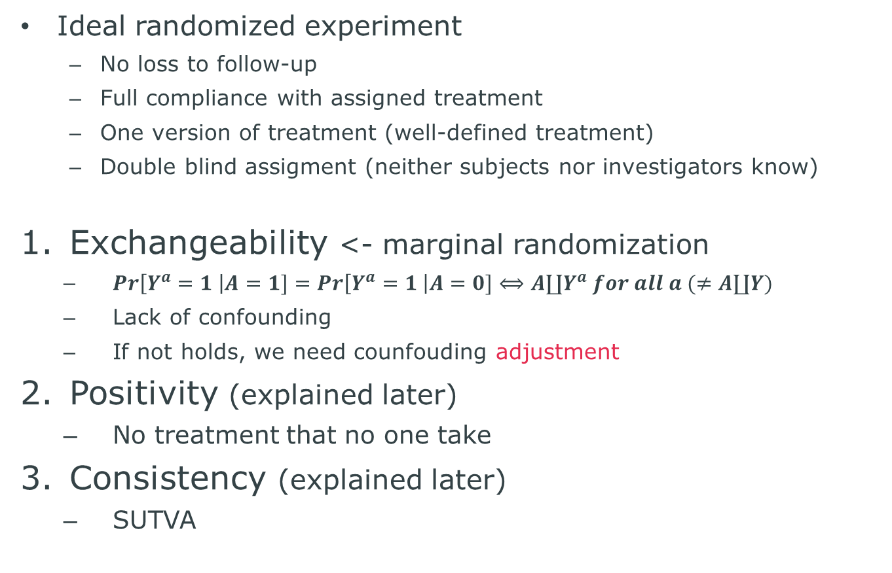
Conditions for causal inference
Ideal randomized experiment
No loss to follow-up
Full compliance with assigned treatment
One version of treatment (well-defined treatment)
Double blind assigment (neither subjects nor investigators know)
Exchangeability <- marginal randomization
$Pr\left[Y^{a}=1 \right|A=1]=Pr\left[Y^{a}=1 \right|A=0]⟺A∐Y^{a} for all a (≠A∐Y)$
Lack of confounding
If not holds, we need counfouding adjustment
Positivity (explained later)
No treatment that no one take
Consistency (explained later)
SUTVA

Slide 9
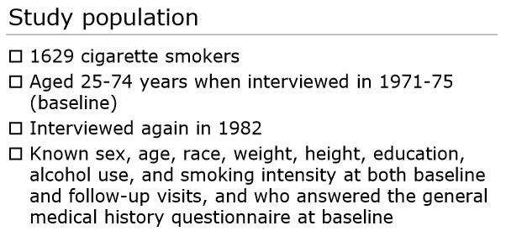
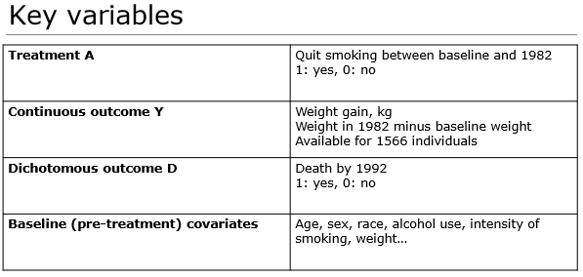
Case study 1

Slide 10
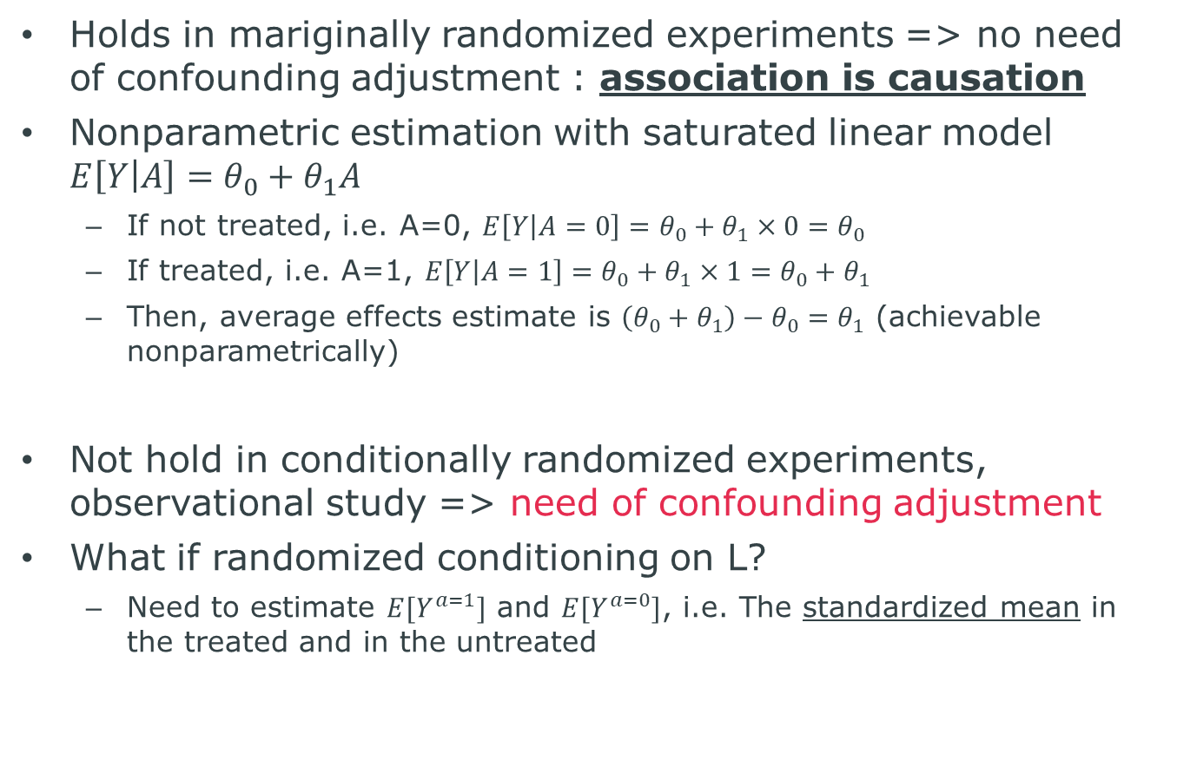
Exchangeability…
Holds in mariginally randomized experiments => no need of confounding adjustment : association is causation
Nonparametric estimation with saturated linear model $E\left[Y | A\right]=θ_{0}+θ_{1}A$
If not treated, i.e. A=0, $E\left[Y | A=0\right]=θ_{0}+θ_{1}×0=θ_{0}$
If treated, i.e. A=1, $E\left[Y | A=1\right]=θ_{0}+θ_{1}×1=θ_{0}+θ_{1}$
Then, average effects estimate is $\left(θ_{0}+θ_{1}\right)−θ_{0}=θ_{1}$ (achievable nonparametrically)
Not hold in conditionally randomized experiments, observational study => need of confounding adjustment
What if randomized conditioning on L?
Need to estimate $E[Y^{a=1}]$ and $E[Y^{a=0}]$, i.e. The standardized mean in the treated and in the untreated

Slide 11
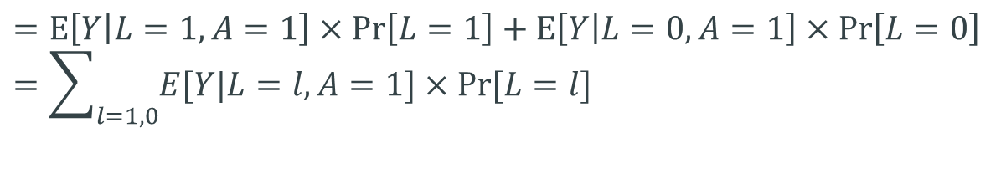
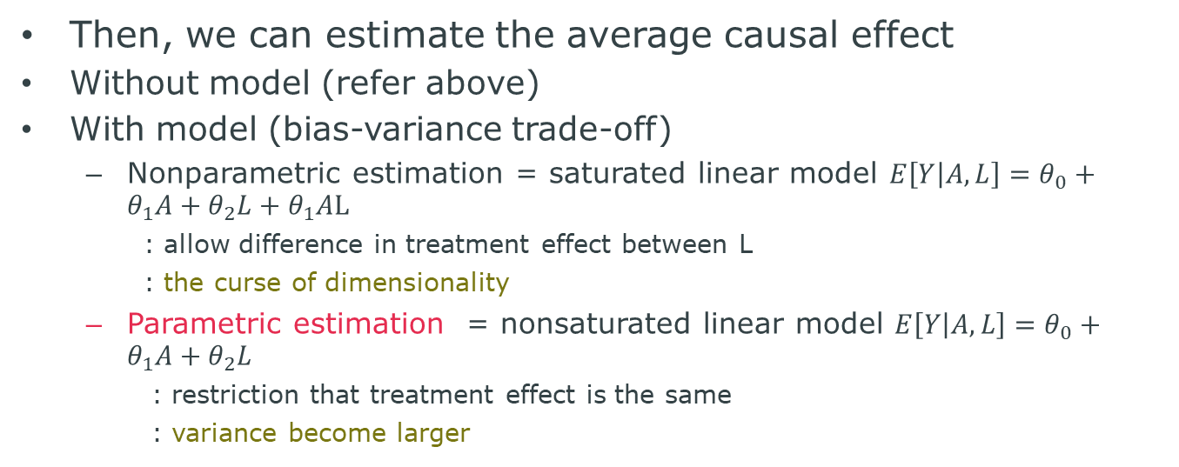
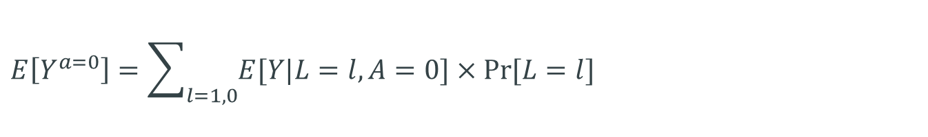
Standardization
$$E\left[Y^{a=1}\right]=E\left[Y^{a=1} | L=1\right]×\operatorname{Pr}\left[L=1\right]+E\left[Y^{a=1} | L=0\right]×\operatorname{Pr}\left[L=0\right]$$
$$=E\left[Y | L=1, A=1\right]×\operatorname{Pr}\left[L=1\right]+E\left[Y | L=0, A=1\right]×\operatorname{Pr}\left[L=0\right]=\sum_{l=1, 0}{E[Y|L=l, A=1]×Pr⁡[L=l]}$$
Exchangeability
$$E\left[Y^{a=0}\right]=\sum_{l=1, 0}{E[Y|L=l, A=0]×Pr⁡[L=l]}$$
Then, we can estimate the average causal effect
Without model (refer above)
With model (bias-variance trade-off)
Nonparametric estimation = saturated linear model $E\left[Y | A, L\right]=θ_{0}+θ_{1}A+θ_{2}L+θ_{1}AL$
: allow difference in treatment effect between L
: the curse of dimensionality
Parametric estimation = nonsaturated linear model $E\left[Y | A, L\right]=θ_{0}+θ_{1}A+θ_{2}L$
: restriction that treatment effect is the same
: variance become larger

Slide 12
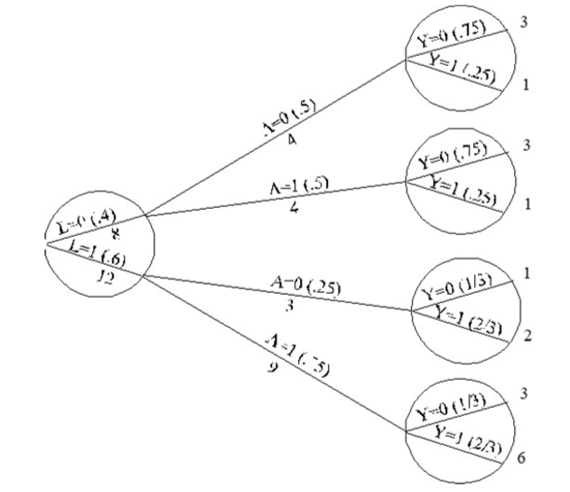
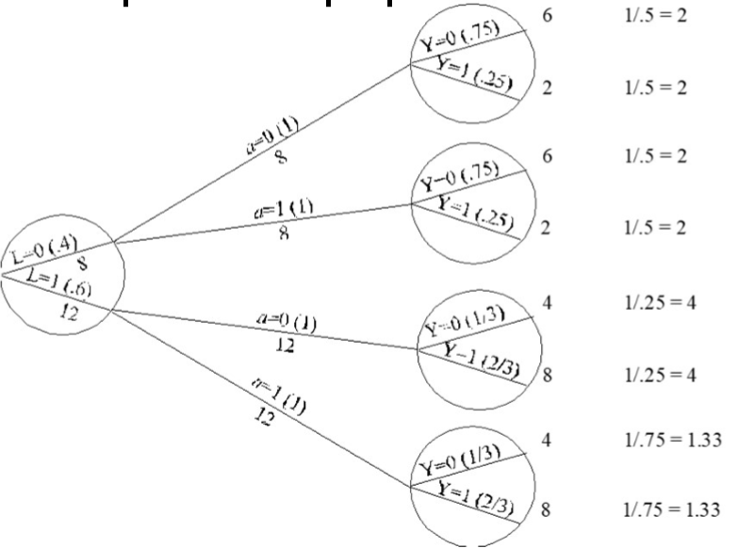
Inverse probability(IP) weighting
IP weighting is anther methods to gain the average causal effects under conditional exchangeability, i.e. adjustment
The goal is to make the pseudo-population with weighting

Slide 13
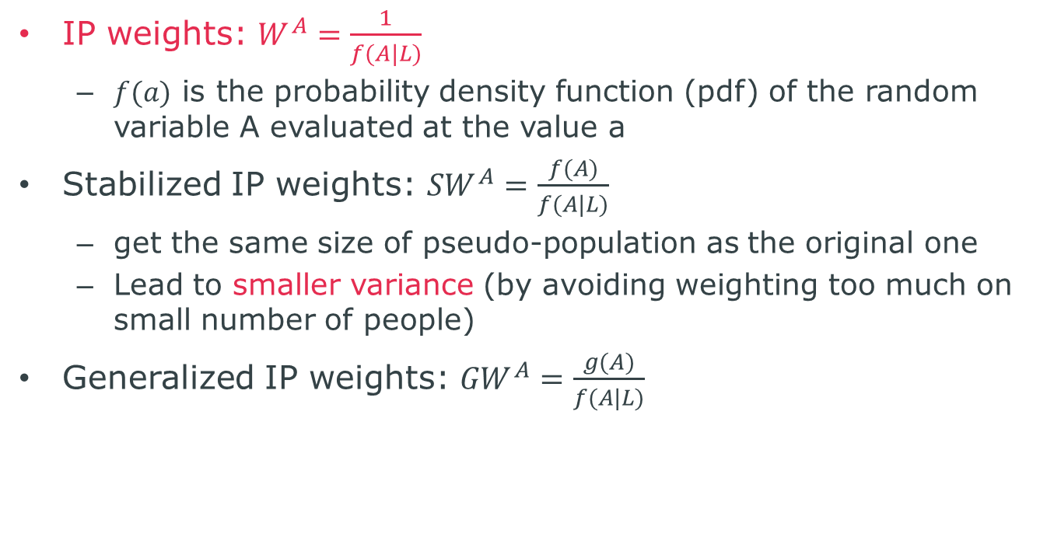
The way of IP weighting and interpretation
IP weights: $W^{A}=\frac{1}{f(A|L)}$
$f(a)$ is the probability density function (pdf) of the random variable A evaluated at the value a
Stabilized IP weights: ${SW}^{A}=\frac{f(A)}{f(A|L)}$
get the same size of pseudo-population as the original one
Lead to smaller variance (by avoiding weighting too much on small number of people)
Generalized IP weights: ${GW}^{A}=\frac{g(A)}{f(A|L)}$

Slide 14
Violations of positivity
Structural
No causal inferences for subsets w/ structural non-positivity
Causal inference by restricting the study population
Random
Causal inference with parametric models to smooth over the subsets w/ non-positivity
…So,
Standardization vs IP weighting ?
In nonparametric estimate, same outcome is acquired
In parametric estimate, the outcome is different
Recommend doubly-robust methods

Slide 15
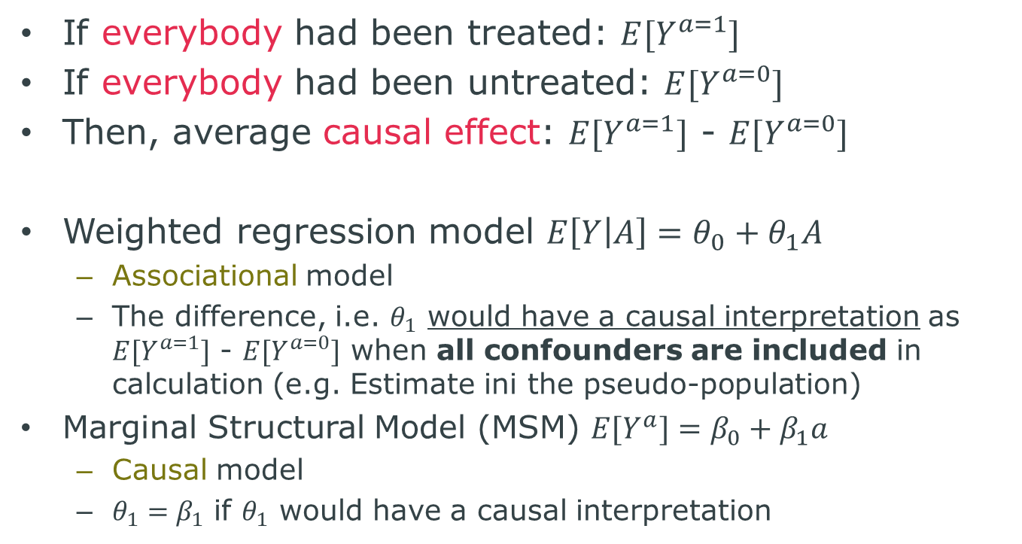
Suppose we want to estimate the causal effect of A on Y…
If everybody had been treated: $E[Y^{a=1}]$
If everybody had been untreated: $E[Y^{a=0}]$
Then, average causal effect: $E[Y^{a=1}]$ - $E[Y^{a=0}]$
Weighted regression model $E\left[Y | A\right]=θ_{0}+θ_{1}A$
Associational model
The difference, i.e. $θ_{1}$ would have a causal interpretation as $E[Y^{a=1}]$ - $E[Y^{a=0}]$ when all confounders are included in calculation (e.g. Estimate ini the pseudo-population)
Marginal Structural Model (MSM) $E[Y^{a}]=β_{0}+β_{1}a$
Causal model
$θ_{1}=β_{1}$ if $θ_{1}$ would have a causal interpretation

Slide 16
Marginal structural model (MSM)
Structural?
Structural = causal
The outcome variable is counterfactual
i.e. parameters for treatment in MSM have direct causal interpretation
Marginal?
Marginal = unconditional
No need to include the confounders as covariates in the model
i.e. effect may be estimated in the entire population
If include covariates, allow to estimate conditional effect
Again, recommend doubly-robust estimators

Slide 17
Advantage of MSM with IP weighting or standardization
IP weighting and standardization are able to control time-varying treatment and confounders
Can handle treatment-confounder feedback
Outcome regression and propensity score methods introduce bias if treatments and confounders are time-variant
Can not handle treatment-confounder feedback

Slide 18
2
Marginal Structural Models and G-estimation of Structural Nested Models
- Judith Lok

Slide 19
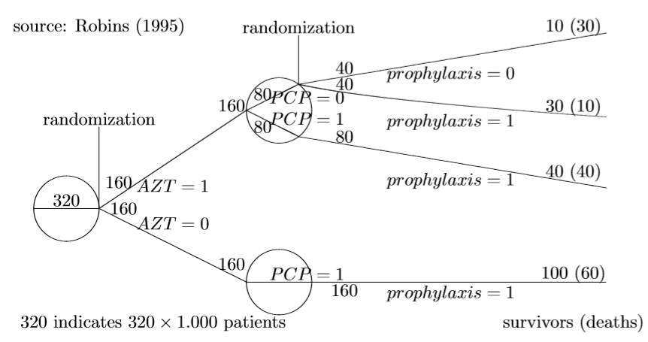
Case study 2
What is the causal effect of AZT on mortality?
AZT (Zidovudine, Retrovir) : anti-HIV drug
PCP : Pneumocystis pneumonia
Prophylaxis : anti-HIV drug

Slide 20
Taking account of the treatment regime
Treatment Regime is
AZT was followed by “no prophylaxis” if no PCP
AZT was followed by “prophylaxis” if PCP
Intention-to-treat assessment?
Conditioning on PCP (might lead to selection bias)?
Also, positivity violation?
Conditioning on prophylaxis?
-> important to talk with subject-matter experts

Slide 21
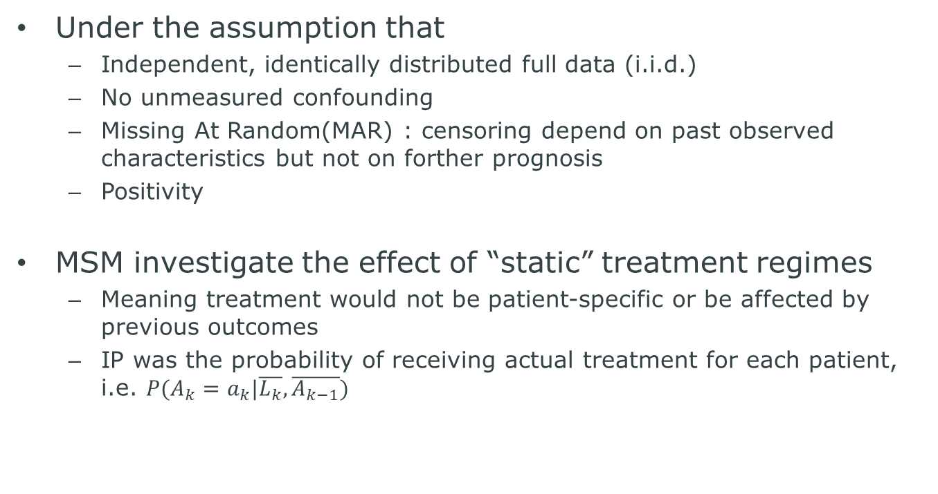
MSM conditioning on past treatment
Under the assumption that
Independent, identically distributed full data (i.i.d.)
No unmeasured confounding
Missing At Random(MAR) : censoring depend on past observed characteristics but not on forther prognosis
Positivity
MSM investigate the effect of “static” treatment regimes
Meaning treatment would not be patient-specific or be affected by previous outcomes
IP was the probability of receiving actual treatment for each patient, i.e. $P(A_{k}=a_{k}|\overline{L_{k}}, \overline{A_{k−1}})$

Slide 22
How to model multistate?
Problem is
Computationally involved
Necessity to model each transition given the past
No specific parameter to indicate whether treatment affects the outcome of interest -> no standard test for treatment effect
Structural Nested Mean Model and Structural Failure Time Models
To estimate the effect of treatment on the final outcome

Slide 23
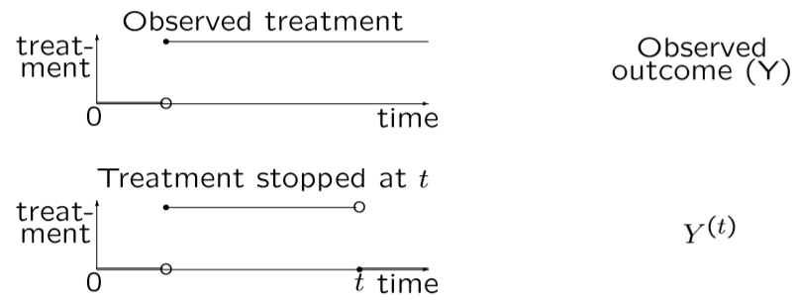
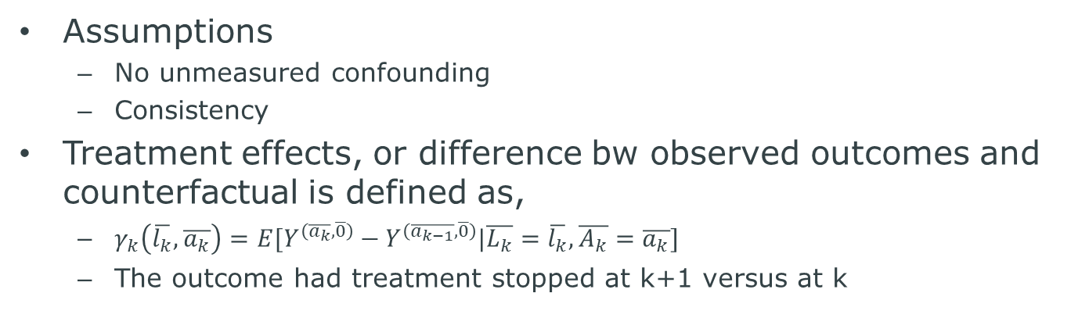
Structural Nested Mean Model (SNMM)
Assumptions
No unmeasured confounding
Consistency
Treatment effects, or difference bw observed outcomes and counterfactual is defined as,
$γ_{k}\left(\overline{l_{k}}, \overline{a_{k}}\right)=E[Y^{\left(\overline{a_{k}}, \overline{0}\right)}−Y^{\left(\overline{a_{k−1}}, \overline{0}\right)}|\overline{L_{k}}=\overline{l_{k}},\overline{A_{k}}=\overline{a_{k}}]$
The outcome had treatment stopped at k+1 versus at k

Slide 24
3
Single World Intervention Graphs and other recent developments in causal inference
- James Robins

Slide 25
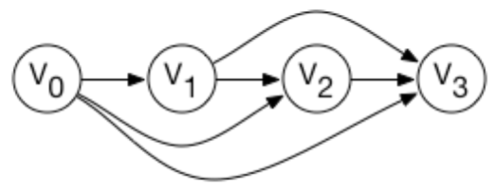
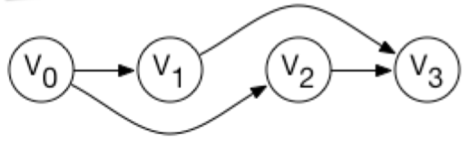
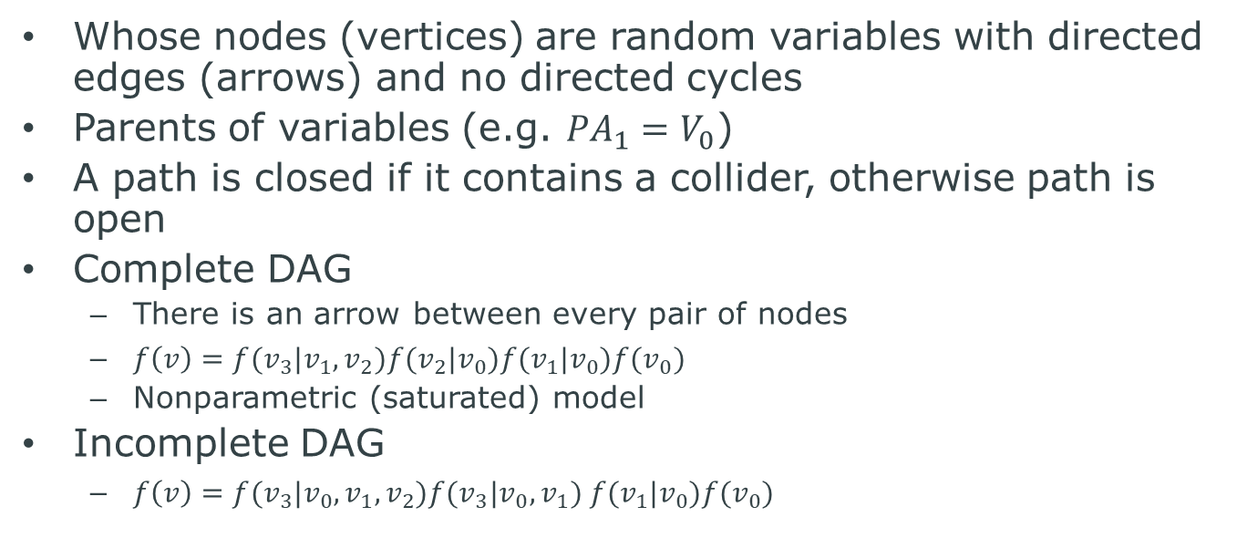
Directed Acyclic Graphs (DAGs)
Whose nodes (vertices) are random variables with directed edges (arrows) and no directed cycles
Parents of variables (e.g. ${PA}_{1}=V_{0}$)
A path is closed if it contains a collider, otherwise path is open
Complete DAG
There is an arrow between every pair of nodes
$f\left(v\right)=f(v_{3}|v_{1}, v_{2})f(v_{2}|v_{0})f(v_{1}|v_{0})f(v_{0})$
Nonparametric (saturated) model
Incomplete DAG
$f\left(v\right)=f(v_{3}|v_{0},v_{1}, v_{2})f(v_{3}|v_{0}, v_{1}) f(v_{1}|v_{0})f(v_{0})$

Slide 26
d-separation and d-connected
D-separation
When no open path between two variables along which probability can flow, we call two variables are d-separated
Otherwise, we call they are d-connected
We also think d-separation and d-connected with condition
If two sets of nodes are d-separated, they will be independent in every distribution in DAG (soundness)
If two sets of nodes are not d-separated, there will be some distribution that they are not independent in DAG (completeness)

Slide 27
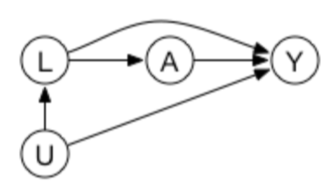
Causal DAGs
Lack of arrows = the absence of direct causal effects
Any variables are causes of all its descendants (vise versa)
All common causes must be on the graph even if they are not measured
Causal Markov Assumption (CMA) is hold: the causal DAG = a statistical DAG = distribution of factors
CMA = conditional on its direct causes, a variable is independent of any variable it does not cause
d-separation implies statistical independence
d-connection does not imply statistical dependence (but generally we assume dependence)

Slide 28
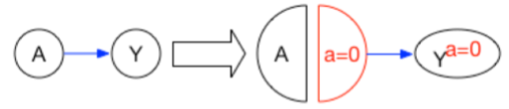
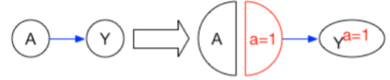
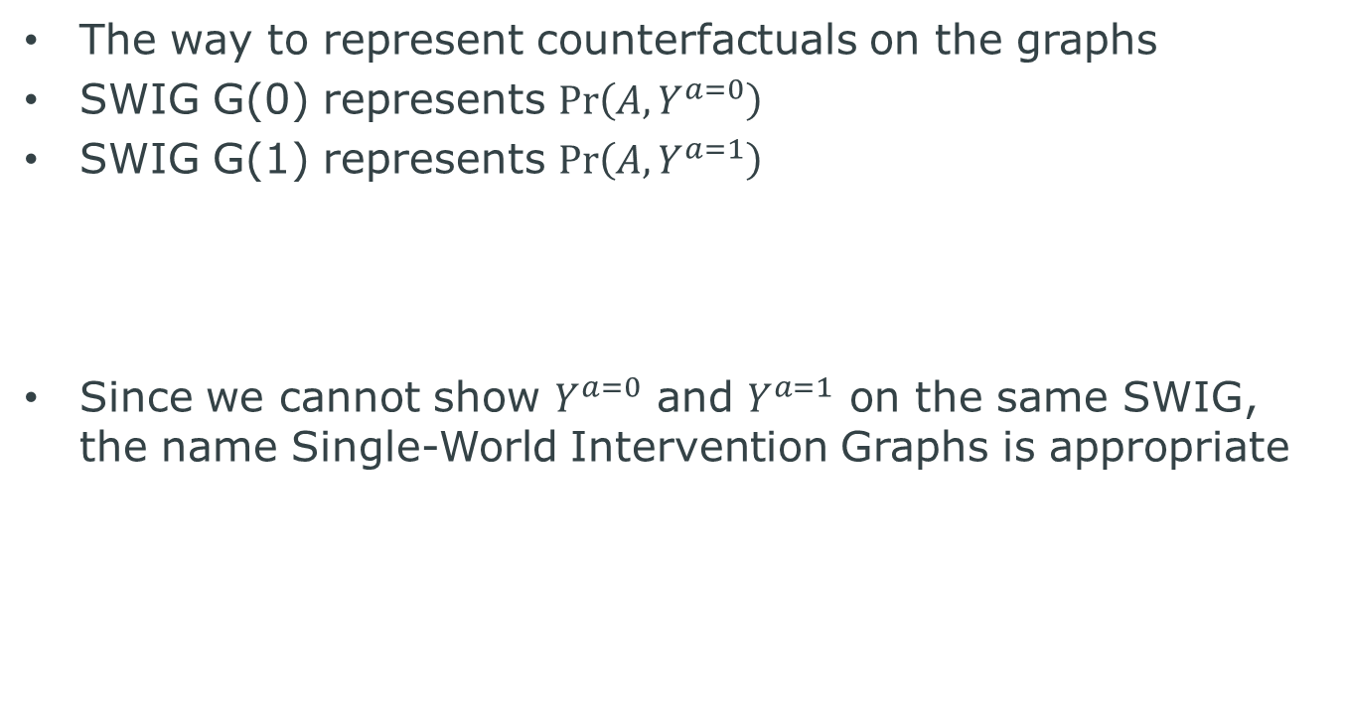
Single-World Intervention Graphs (SWIGs)
The way to represent counterfactuals on the graphs
SWIG G(0) represents $\operatorname{Pr}\left(A, Y^{a=0}\right)$
SWIG G(1) represents $\operatorname{Pr}\left(A, Y^{a=1}\right)$
Since we cannot show $Y^{a=0}$ and $Y^{a=1}$ on the same SWIG, the name Single-World Intervention Graphs is appropriate

Slide 29
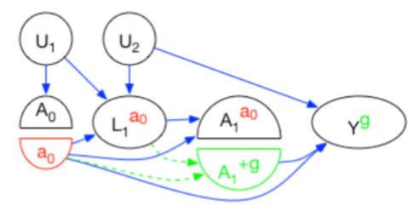
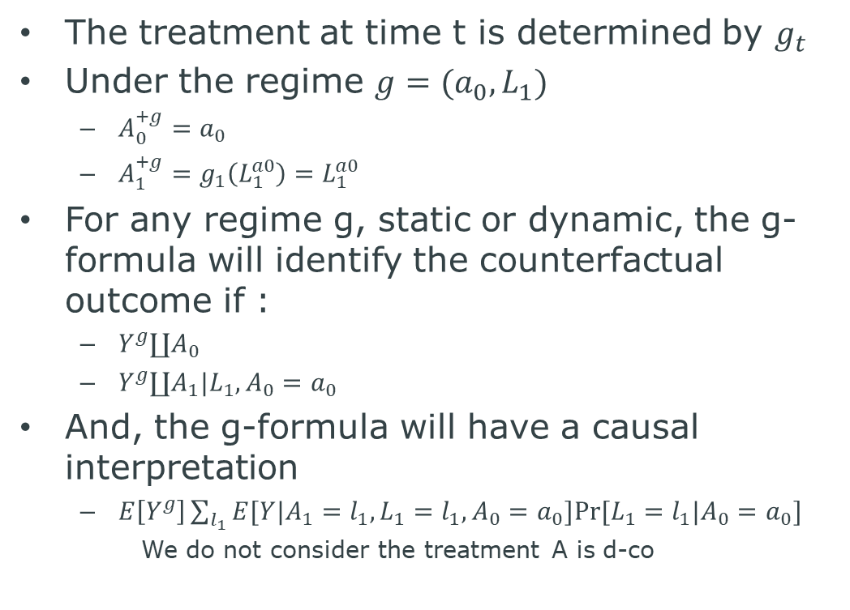
SWIGs for dynamic regimes
The treatment at time t is determined by $g_{t}$
Under the regime $g=(a_{0},L_{1})$
$A_{0}^{+g}=a_{0}$
$A_{1}^{+g}=g_{1}\left(L_{1}^{a0}\right)=L_{1}^{a0}$
For any regime g, static or dynamic, the g-formula will identify the counterfactual outcome if :
$Y^{g}∐A_{0}$
$Y^{g}∐A_{1}|L_{1},A_{0}=a_{0}$
And, the g-formula will have a causal interpretation
$E\left[Y^{g}\right]\sum_{l_{1}}{E[Y|A_{1}=l_{1},}L_{1}=l_{1},A_{0}=a_{0}]Pr⁡[L_{1}=l_{1}|A_{0}=a_{0}]$
We do not consider the treatment A is d-co

Slide 30
4
Causal Mediation Analysis
- Tyler VanderWeele

Slide 31
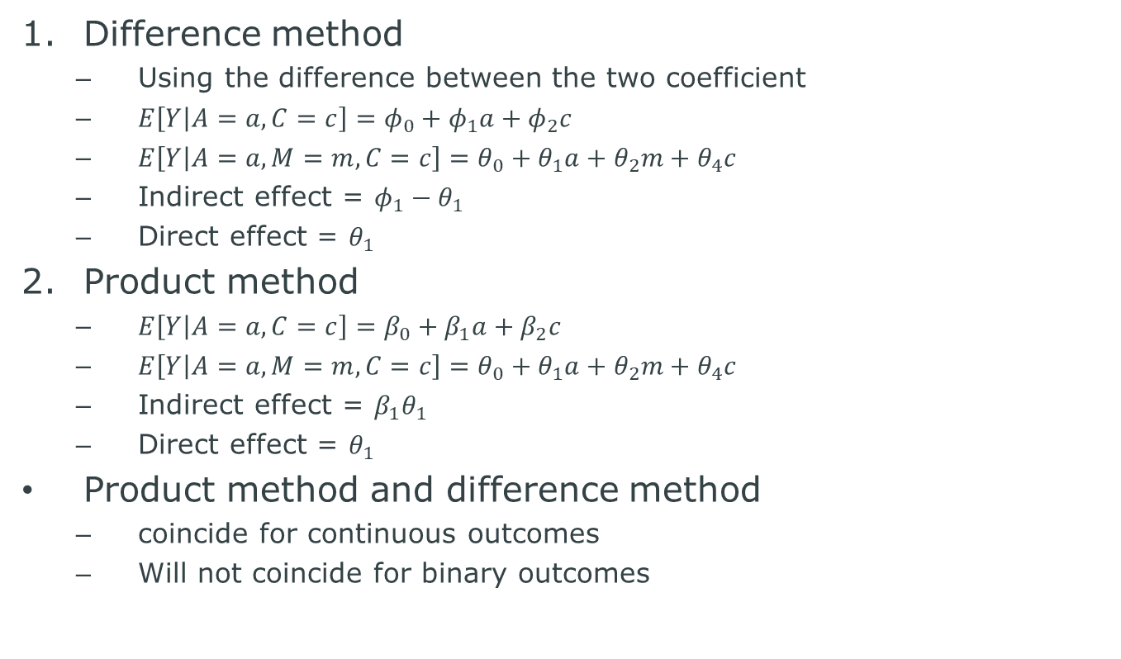
Standard approach to investigate mediation
Difference method
Using the difference between the two coefficient
$E\left[Y | A=a, C=c\right]=φ_{0}+φ_{1}a+φ_{2}c$
$E\left[Y | A=a, M=m, C=c\right]=θ_{0}+θ_{1}a+θ_{2}m+θ_{4}c$
Indirect effect = $φ_{1}−θ_{1}$
Direct effect = $θ_{1}$
Product method
$E\left[Y | A=a, C=c\right]=β_{0}+β_{1}a+β_{2}c$
$E\left[Y | A=a, M=m, C=c\right]=θ_{0}+θ_{1}a+θ_{2}m+θ_{4}c$
Indirect effect = $β_{1}θ_{1}$
Direct effect = $θ_{1}$
Product method and difference method
coincide for continuous outcomes
Will not coincide for binary outcomes

Slide 32
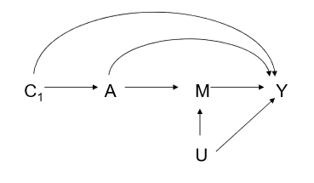
Limitation1: Mediator-outcome confounding
Just as unmeasured exposure-outcome confounders can generate confounding bias of estimates of overall effects, mediator-outcome confounders can generate bias of estimates of direct and indirect effects
Meaning, we might get paradoxical result!
Approach 1) pay attention to mediator-outcome confounding variables even during study design stage
Approach 2) conduct sensitivity analysis

Slide 33
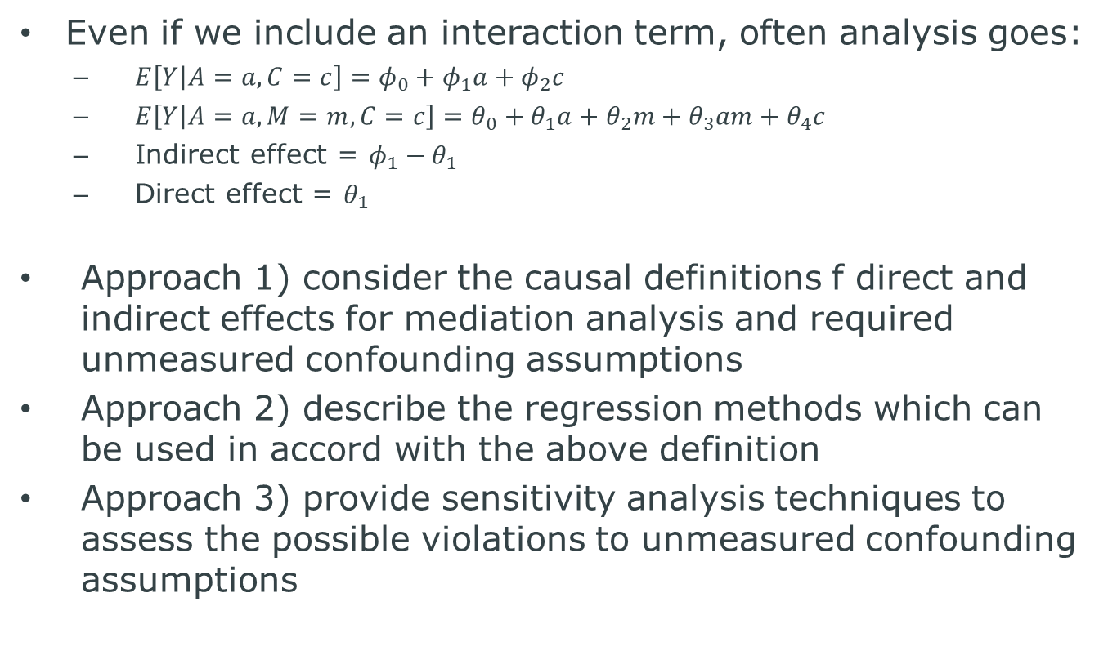
Limitation2:exposure-mediator interactions
Even if we include an interaction term, often analysis goes:
$E\left[Y | A=a, C=c\right]=φ_{0}+φ_{1}a+φ_{2}c$
$E\left[Y | A=a, M=m, C=c\right]=θ_{0}+θ_{1}a+{θ_{2}m+θ_{3}am+θ}_{4}c$
Indirect effect = $φ_{1}−θ_{1}$
Direct effect = $θ_{1}$
Approach 1) consider the causal definitions f direct and indirect effects for mediation analysis and required unmeasured confounding assumptions
Approach 2) describe the regression methods which can be used in accord with the above definition
Approach 3) provide sensitivity analysis techniques to assess the possible violations to unmeasured confounding assumptions

Slide 34
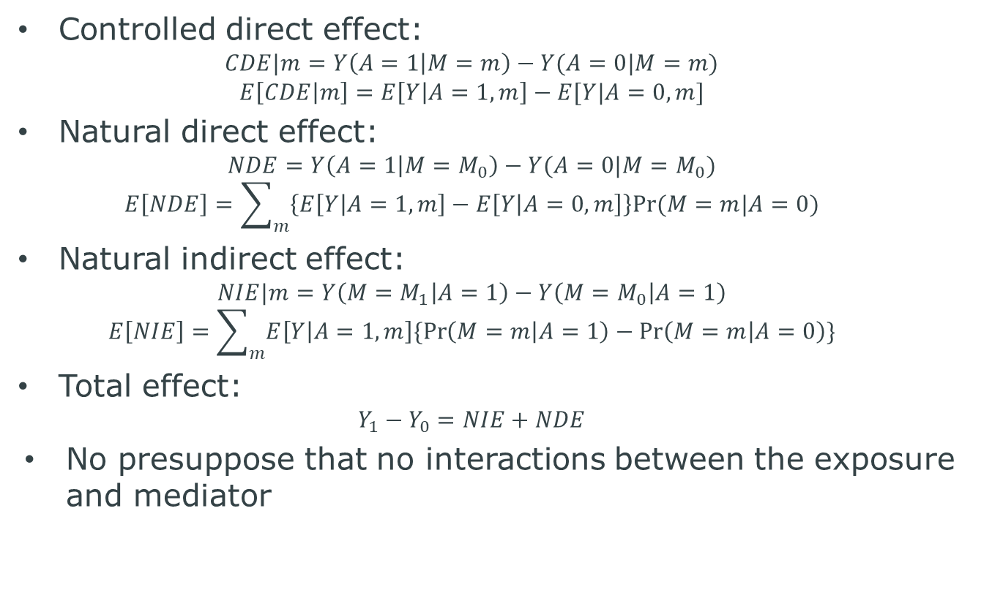
Approach 1) Definitions
Controlled direct effect:
$$CDE|m=Y\left(A=1 | M=m\right)−Y(A=0|M=m)$$
$$E\left[CDE | m\right]=E\left[Y | A=1, m\right]−E[Y|A=0,m]$$
Natural direct effect:
$$NDE=Y\left(A=1 | M=M_{0}\right)−Y(A=0|M=M_{0})$$
$$E\left[NDE\right]=\sum_{m}{\left\{E\left[Y | A=1,m\right]−E\left[Y | A=0,m\right]\right\}Pr⁡(M=m|A=0)}$$
Natural indirect effect:
$$NIE|m=Y\left(M=M_{1} | A=1\right)−Y\left(M=M_{0} | A=1\right)$$
$$E\left[NIE\right]=\sum_{m}{E\left[Y | A=1,m\right]\{\operatorname{Pr}\left(M=m | A=1\right)−\operatorname{Pr}\left(M=m | A=0\right)\}}$$
Total effect:
$$Y_{1}−Y_{0}=NIE+NDE$$
No presuppose that no interactions between the exposure and mediator

Slide 35
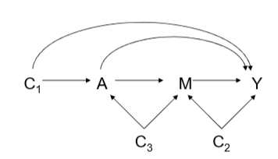
Approach 1) no unmeasured confounder assumption
No unmeasured exposure-outcome confounders given C
No unmeasured mediator-outcome confounders given (C,A)
No unmeasured exposure-mediator confounders given C
No unmeasured mediator-outcome confounder affected by exposure

Slide 36
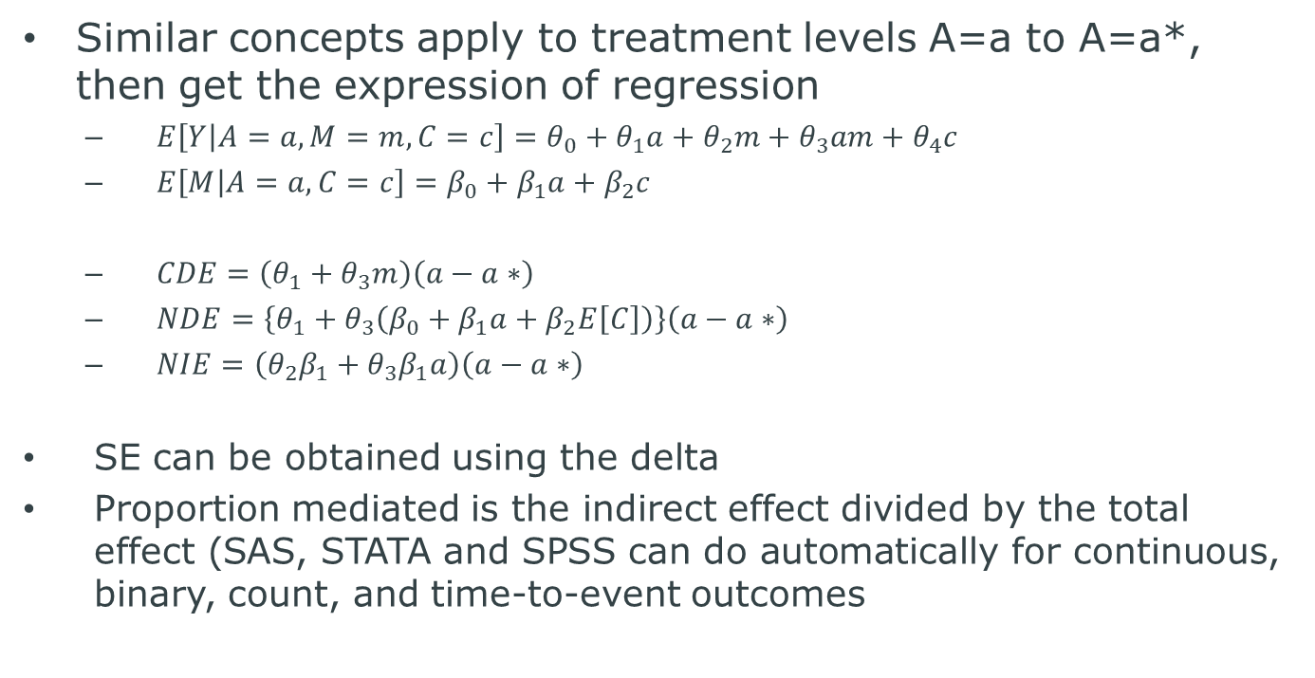
Approach 2) Regression model for causal mediation analysis
Similar concepts apply to treatment levels A=a to A=a*, then get the expression of regression
$E\left[Y | A=a, M=m, C=c\right]=θ_{0}+θ_{1}a+θ_{2}m+θ_{3}am+θ_{4}c$
$E\left[M | A=a, C=c\right]=β_{0}+β_{1}a+β_{2}c$
$CDE=\left(θ_{1}+θ_{3}m\right)\left(a−a∗\right)$
$NDE=\left\{θ_{1}+θ_{3}\left(β_{0}+β_{1}a+β_{2}E\left[C\right]\right)\right\}\left(a−a∗\right)$
$NIE=\left(θ_{2}β_{1}+θ_{3}β_{1}a\right)\left(a−a∗\right)$
SE can be obtained using the delta
Proportion mediated is the indirect effect divided by the total effect (SAS, STATA and SPSS can do automatically for continuous, binary, count, and time-to-event outcomes

Slide 38
Approach 2) cautions for binary outcomes
Difference method for a dichotomous outcomes and logistic regression will give valid estimates, provided
Model without the interaction is correctly specified
No unmeasured confounding assumptions are satisfied
Outcome is rare (can be relaxed by using log-linear)
With common outcome, the difference method fails with logistic regression due to non-collapsibility
Monte Carlo approach, a simulation-based approach give more flexibility

Slide 39
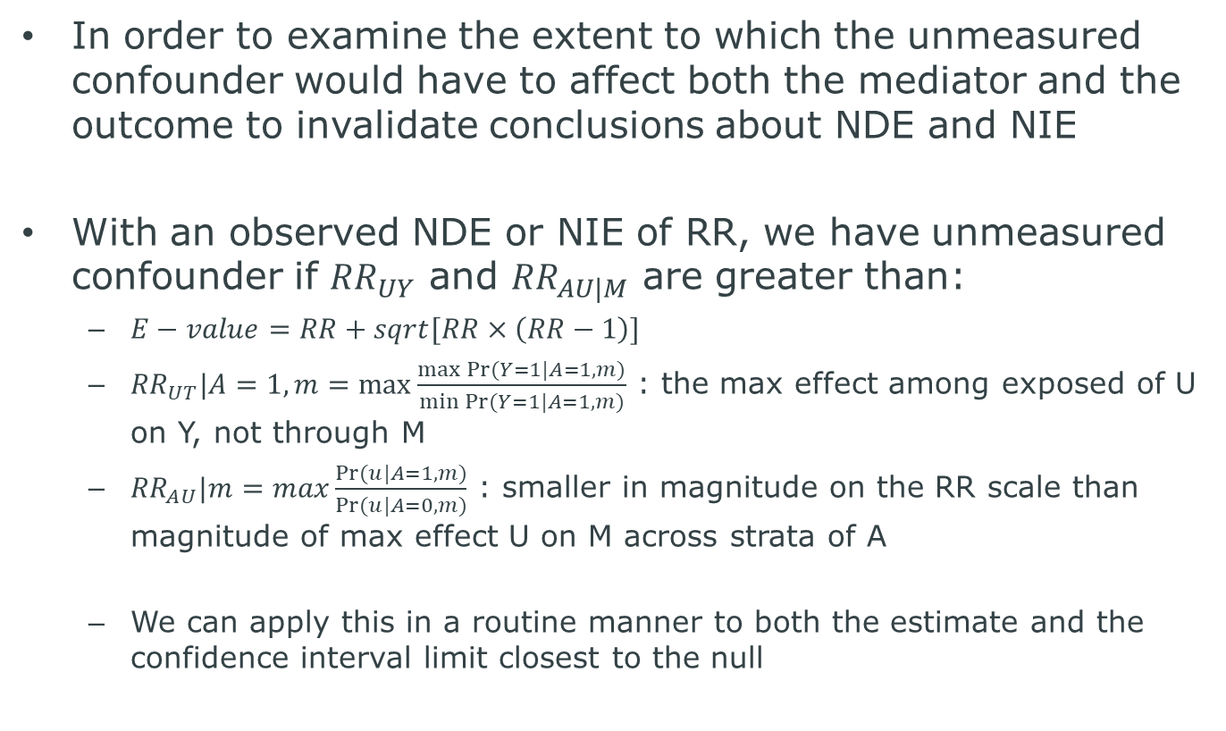
Approach 3) sensitivity analysis
In order to examine the extent to which the unmeasured confounder would have to affect both the mediator and the outcome to invalidate conclusions about NDE and NIE
With an observed NDE or NIE of RR, we have unmeasured confounder if ${RR}_{UY}$ and ${RR}_{AU|M}$ are greater than:
$E−value=RR+sqrt[RR×\left(RR−1\right)]$
${RR}_{UT}|A=1, m=max\frac{\max{Pr⁡(Y=1|A=1,m)}}{\min{Pr⁡(Y=1|A=1,m)}}$ : the max effect among exposed of U on Y, not through M
${RR}_{AU}|m=max\frac{Pr⁡(u|A=1,m)}{Pr⁡(u|A=0,m)}$ : smaller in magnitude on the RR scale than magnitude of max effect U on M across strata of A
We can apply this in a routine manner to both the estimate and the confidence interval limit closest to the null

Slide 40
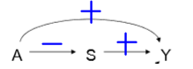
Surrogate paradox
“surrogate paradox” is manifest if
The surrogate and outcome are strongly positively correlated
The treatment has a positive effect on the surrogate
The treatment has a negative effect on the outcome
Might happen if
E[Y|a,s,u] is NOT non-decreasing in a, i.e. a negative direct effect of A on Y, OR
E[Y|a,su] is NOT non-decreasing in s, i.e. the positive correlation of S and Y is not because of the actual effect but because of confounding, OR
P(S>s|a,u) is NOT non-decreasing in a, i.e. transitivity fails; A affects S for different people than S affects Y

Slide 41
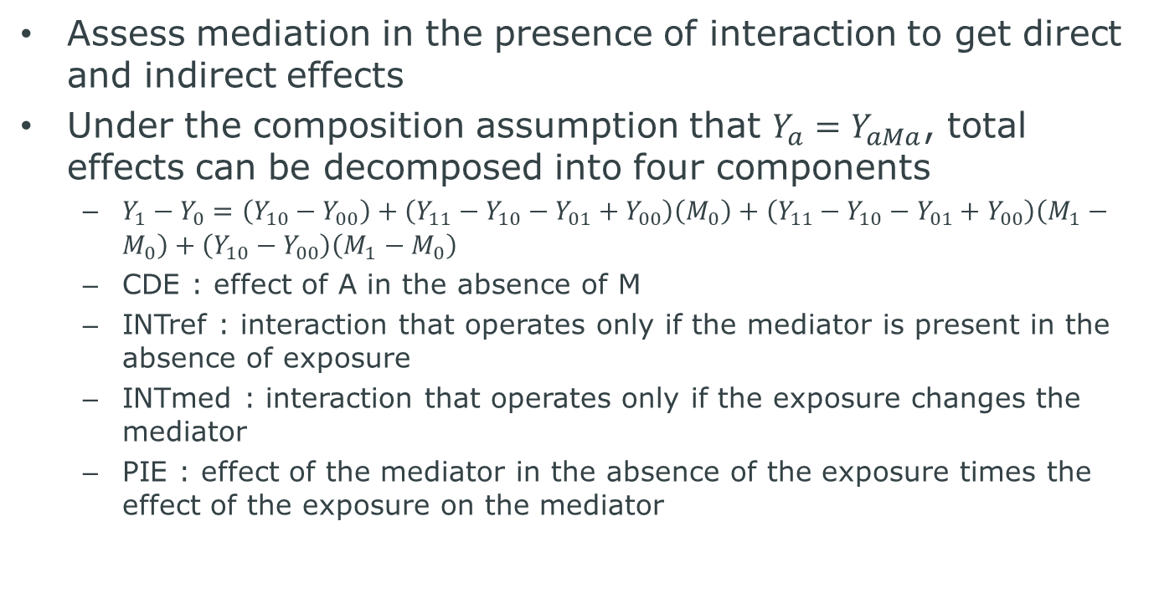
Unification of Mediation and Interaction
Assess mediation in the presence of interaction to get direct and indirect effects
Under the composition assumption that $Y_{a}=Y_{aMa}$, total effects can be decomposed into four components
$Y_{1}−Y_{0}=\left(Y_{10}−Y_{00}\right)+\left(Y_{11}−Y_{10}−Y_{01}+Y_{00}\right)\left(M_{0}\right)+\left(Y_{11}−Y_{10}−Y_{01}+Y_{00}\right)\left(M_{1}−M_{0}\right)+\left(Y_{10}−Y_{00}\right)\left(M_{1}−M_{0}\right)$
CDE : effect of A in the absence of M
INTref : interaction that operates only if the mediator is present in the absence of exposure
INTmed : interaction that operates only if the exposure changes the mediator
PIE : effect of the mediator in the absence of the exposure times the effect of the exposure on the mediator

Slide 42
5
Causal Methods to Tame Unmeasured Confouding
- Eric Tchetgen Tchetgen

Slide 43
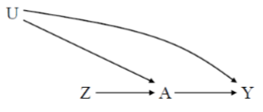
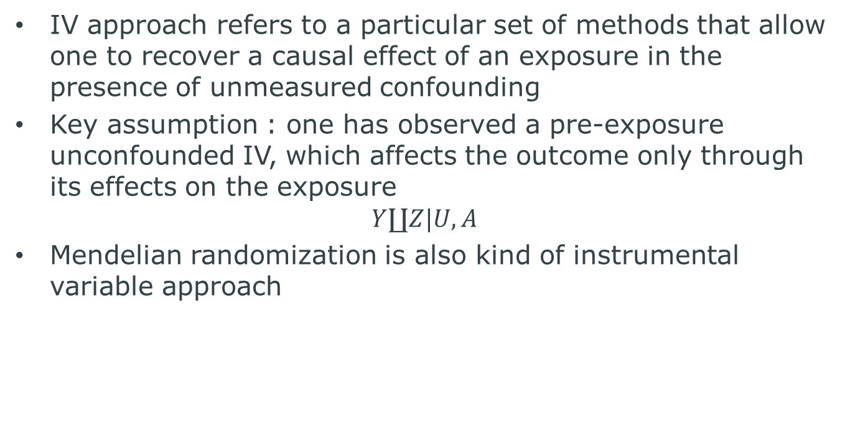
Instrumental variable (IV)
IV approach refers to a particular set of methods that allow one to recover a causal effect of an exposure in the presence of unmeasured confounding
Key assumption : one has observed a pre-exposure unconfounded IV, which affects the outcome only through its effects on the exposure
$$Y∐Z|U,A$$
Mendelian randomization is also kind of instrumental variable approach

Slide 44
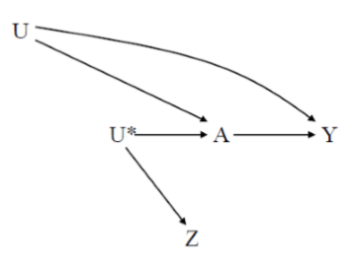
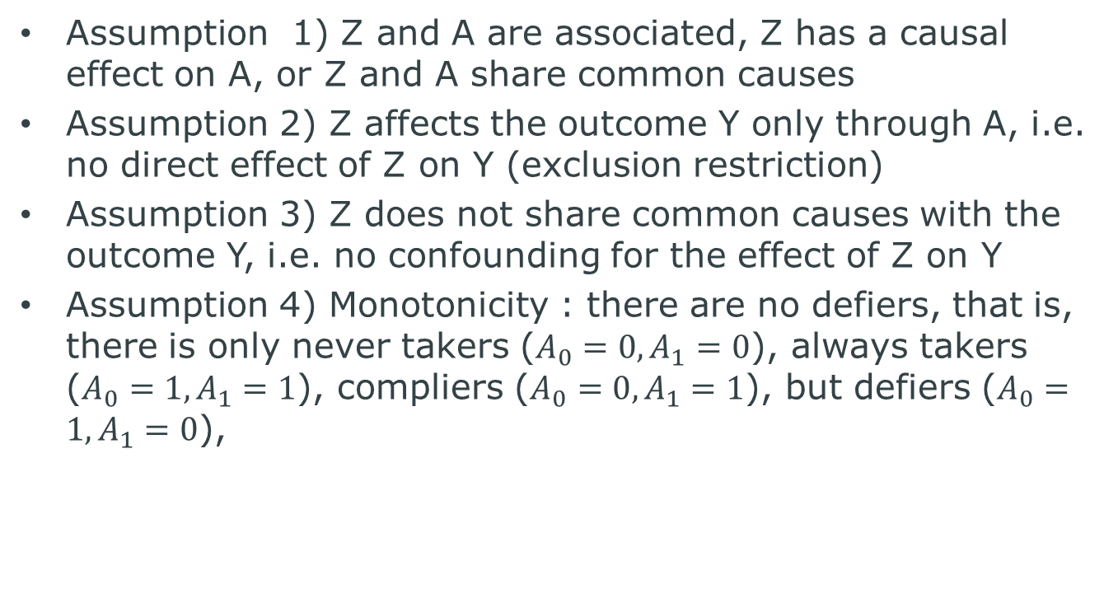
Formal definition of IV
Assumption 1) Z and A are associated, Z has a causal effect on A, or Z and A share common causes
Assumption 2) Z affects the outcome Y only through A, i.e. no direct effect of Z on Y (exclusion restriction)
Assumption 3) Z does not share common causes with the outcome Y, i.e. no confounding for the effect of Z on Y
Assumption 4) Monotonicity : there are no defiers, that is, there is only never takers ($A_{0}=0, A_{1}=0$), always takers ($A_{0}=1, A_{1}=1$), compliers ($A_{0}=0, A_{1}=1$), but defiers ($A_{0}=1, A_{1}=0$),

Slide 45
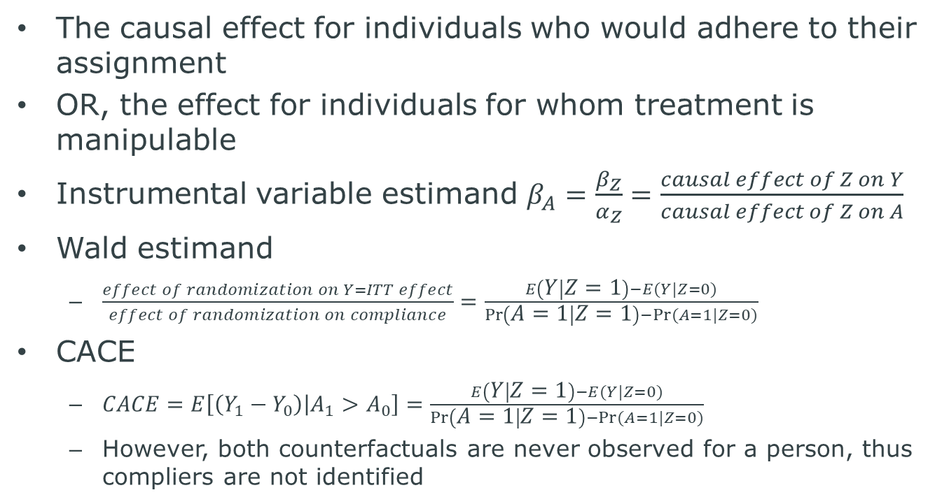
Complier average causal effect(CACE)
The causal effect for individuals who would adhere to their assignment
OR, the effect for individuals for whom treatment is manipulable
Instrumental variable estimand $β_{A}=\frac{β_{Z}}{α_{Z}}=\frac{causal effect of Z on Y}{causal effect of Z on A}$
Wald estimand
$\frac{effect of randomization on Y=ITT effect}{effect of randomization on compliance}=\frac{E\left(Y | Z=1\right)−E(Y|Z=0)}{\operatorname{Pr}\left(A=1 | Z=1\right)−Pr⁡(A=1|Z=0)}$
CACE
$CACE=E\left[\left(Y_{1}−Y_{0}\right) | A_{1}>A_{0}\right]=\frac{E\left(Y | Z=1\right)−E(Y|Z=0)}{\operatorname{Pr}\left(A=1 | Z=1\right)−Pr⁡(A=1|Z=0)}$
However, both counterfactuals are never observed for a person, thus compliers are not identified

Slide 46
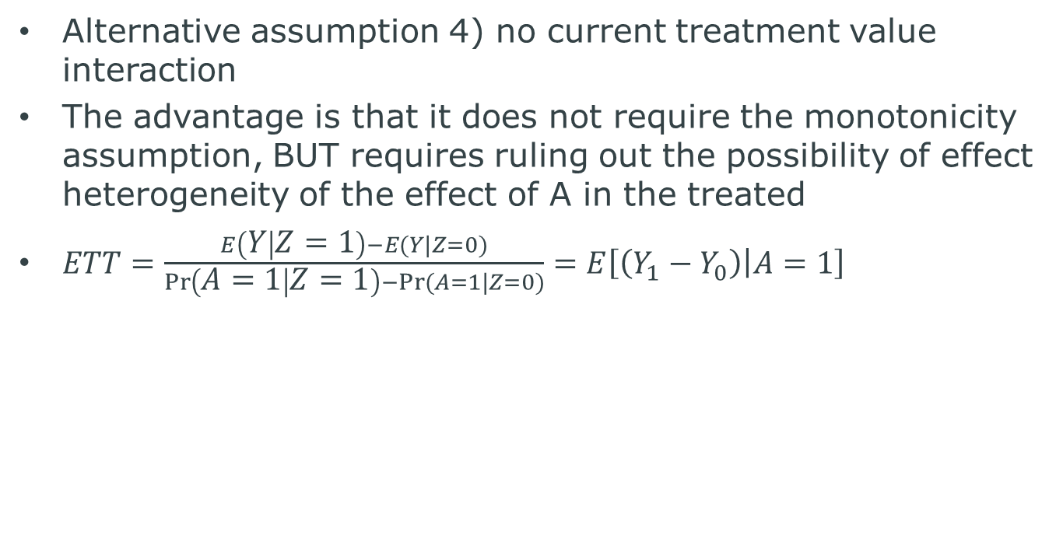
Effect of treatment on the treated (ETT)
Alternative assumption 4) no current treatment value interaction
The advantage is that it does not require the monotonicity assumption, BUT requires ruling out the possibility of effect heterogeneity of the effect of A in the treated
$ETT=\frac{E\left(Y | Z=1\right)−E(Y|Z=0)}{\operatorname{Pr}\left(A=1 | Z=1\right)−Pr⁡(A=1|Z=0)}=E\left[\left(Y_{1}−Y_{0}\right) | A=1\right]$

Slide 47

Average Causal Effect (ACE)
Required extra assumption 5) homogeneity assumption
$ACE=E\left(Y_{a=1}−Y_{a=0}\right)=\frac{E\left(Y | Z=1\right)−E(Y|Z=0)}{\operatorname{Pr}\left(A=1 | Z=1\right)−Pr⁡(A=1|Z=0)}$

Slide 48
Covariates
In the IV approach, we must account for covariates to
Account for confounding of the effects of Z on Y, and preventing a violation of the exclusion restriction by C
Partially account for confounding of the effects of A on Y
Explain variation in the outcome Y to improve efficiency

Slide 49
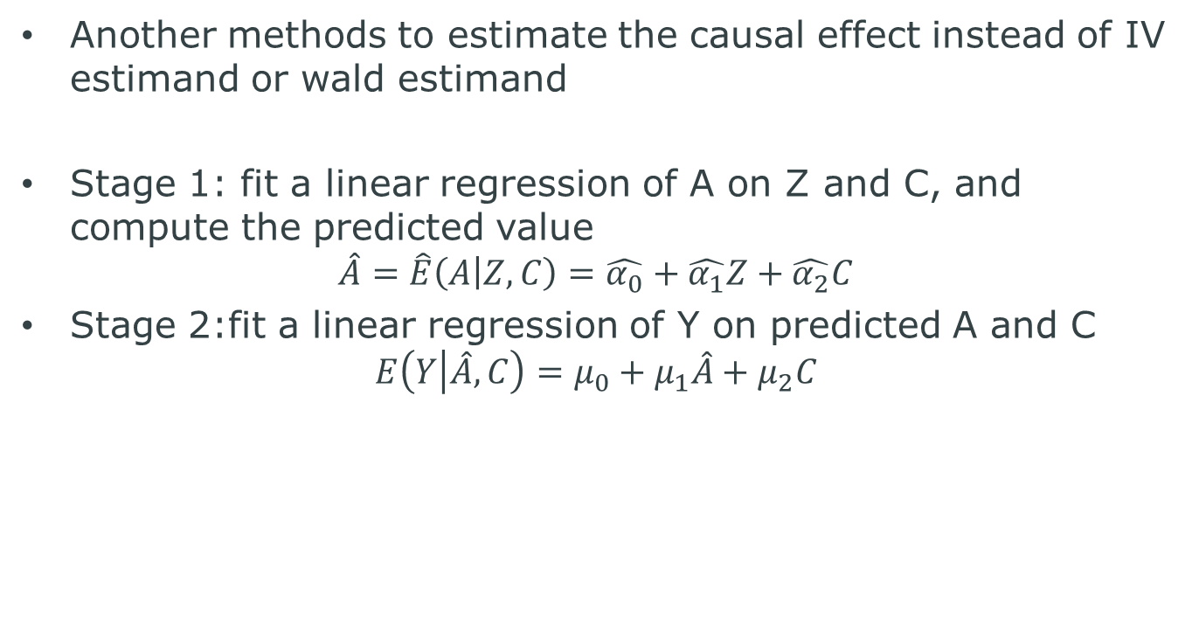
Two stage least square (2SLS)
Another methods to estimate the causal effect instead of IV estimand or wald estimand
Stage 1: fit a linear regression of A on Z and C, and compute the predicted value
$$\hat{A}=\hat{E}\left(A | Z,C\right)=\hat{α_{0}}+\hat{α_{1}}Z+\hat{α_{2}}C$$
Stage 2:fit a linear regression of Y on predicted A and C
$$E\left(Y | \hat{A},C\right)=μ_{0}+μ_{1}\hat{A}+μ_{2}C$$

Slide 50
Thank you for your attention!

